Slide 1
Cassandra backups and restorations using Ansible
Dr. Joshua Wickman
Database Engineer
Knewton

Slide 2

Relevant technologies
AWS infrastructure
Deployment and configuration management with Ansible
Ansible is built on:
Python
YAML
SSH
Jinja2 templating
Agentless - less complexity

Slide 3
Ansible playbook sample
---
- hosts: < host group specification >
serial: 1
pre_tasks:
- name: ask for human confirmation
local_action:
module: pause
prompt: Confirm action on {{ play_hosts | length }} hosts?
run_once: yes
tags:
- always
- hostcount
< more setup tasks >
roles:
- role: base
- role: cassandra-install
- role: cassandra-configure
post_tasks:
- name: wait to make sure cassandra is up
wait_for:
host: '{{ inventory_hostname }}'
port: 9160
delay: "{{ pause_time | default(15) }}"
timeout: "{{ listen_timeout | default(120) }}"
ignore_errors: yes
< more post-startup tasks >
- name: install and configure alerts
include: monitoring.yml
< more plays >
One host at a time (default: all in parallel)
Tags allow task filtering
Can execute on local or remote host
A single “play”
Roles define complex, repeatable rule sets
Built-in variables
Import other playbooks
Template with default
Sample command:
ansible-playbook path/to/sample_playbook.yml -i host_file -e "listen_timeout=30"
Notes:
Not called out directly:
Run once
Ignore errors

Slide 4

Knewton’s Cassandra deployment
Running on AWS instances in a VPC
Ansible repo contains:
Dynamic host inventory
Configuration details for Cassandra nodes
Config file templates (cassandra.yaml, etc)
Variable defaults
Roles and playbooks for Cassandra node operations:
Create / provision new nodes
Rolling restart a cluster
Upgrade a cluster
Backups and restores

Slide 5



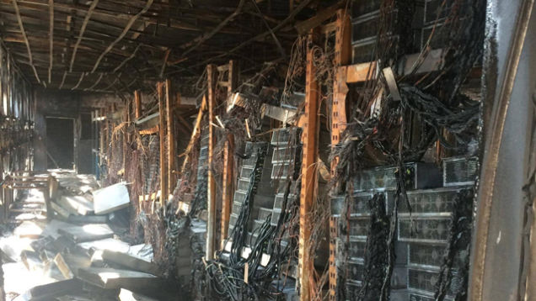
Backups for disaster recovery
Data loss
Data corruption
AZ/rack loss
Data center loss
Notes:
AZ loss problem removed if each AZ has a complete copy of the data

Slide 6

But that’s not all...
Restored backups are also useful for:
Benchmarking
Data warehousing
Batch jobs
Load testing
Corruption testing
Tracking down incident causes

Slide 7
Backups
Those sound like a good idea. I can get those for you, no sweat!

Slide 8
Backups — requirements
Simple to use
Centralized, yet distributed
Low impact
Built with restores in mind
Easy with Ansible
Obvious, but super important to get right!

Slide 9
Backup playbook
Ansible run initiated
Commands sent to each Cassandra node over SSH
nodetool snapshot on each node
Snapshot uploaded to S3
Via AWS CLI
Metadata gathered centrally by Ansible and uploaded to S3
Backup retention policies enforced by separate process
Ansible
SSH
Cassandra cluster
AWS CLI
AWS S3
Retention
enforcement
Notes:
4) Nice is used for low impact
6) Bucket lifecycle policies are also used. Separate process is for higher granularity.

Slide 10
Backup metadata
{
"ips": [
"123.45.67.0",
"123.45.67.1",
"123.45.67.2"
],
"ts": "2016-09-01T01:23:45.987654",
"version": "2.1",
"tokens": {
"1a": [
{
"tokens": [...],
"hostname": "sample-0"
},
"1c": [
{
"tokens": [...],
"hostname": "sample-2"
},
...
]
}
}
IP list for cluster history / backup source tracking
Needed for restores:
Cassandra version
Token ranges
AZ mapping
SSTable compatibility
For partitioner
More on this later
Notes:
Hostnames:
We use these in S3 paths as a unique source identifier. May not be needed depending on implementation.

Slide 11

Backups — results
Simple and predictable
Clusterwide snapshots
Low impact
Automation-ready
Everything’s good!
...right?
Notes:
Impact: nice
Automation: cron, Tower, etc

Slide 12
Restores
Oh, you actually wanted to use that data again? That’s… harder.

Slide 13
Restores — requirements
Primary
Data consistency across nodes
Data integrity maintained
Time to recovery
Secondary
Multiple snapshots at a time
Can be automated or run on-demand
Versatile end state
Spin up new cluster using restored data
Notes:
Consistency: data agrees to within C* internals
Integrity: no corruption induced by restore
Time: ~few hours

Slide 14
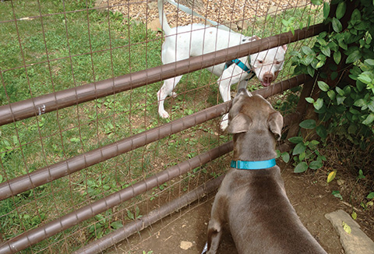
Restored cluster — requirements
Entirely separate from live cluster
Same configuration as at snapshot
No common members
No common seeds
Distinct provisioning identifiers
For us: AWS tags
Cassandra version
Number of nodes
Token ranges
Rack distribution
On AWS: availability zones (AZs)
Contained in backup metadata
Restore-focused backups

Slide 15

Ansible in the cloud — a caveat
Programmatic launch of servers
+
Ansible host discovery happens once per playbook
=
Launching cluster requires 2 steps:
Create instances
Provision instances as Cassandra nodes

Slide 16
Restore playbook 1: create nodes
Get metadata from S3
Find number of nodes in original cluster
Create new nodes
New cluster name is stamped with snapshot ID, allowing:
Easy distinction from live cluster
Multiple concurrent restores per cluster
S3
Ansible
New Cassandra cluster

Slide 17
Restore playbook 2: provision nodes
Get metadata from S3 (again)
Parse metadata
Map source to target
Find matching files in S3
Filter out some Cassandra system tables
Partially provision nodes
Install Cassandra
Use original C* version
Mount data partition
Download snapshot data to nodes
Configure Cassandra and finish provisioning nodes
S3
Ansible
New Cassandra cluster
S3
LOADED
Notes:
Filtered keyspaces:
Peers
Local
NOT schema!
Highlight box:
Minimum metadata collected
Combination of old & new config settings:
Critical: stored in S3
Non-critical: use what’s in repo
Approach assumes:
Snapshot being restored is recent
Config changes are rare
Could store more config details, up to entire cassandra.yaml

Slide 18

Restores: node mapping
Source ⇒ Target
Include token ranges
Source AZs ⇒ Target AZs

Slide 19
Restores: random AZ assignment
Source cluster
1a
1c
1d
1a
1c
1d
1a
1c
1d
1a
1c
1d
Restored cluster

Slide 20
Why is this a problem?
With NetworkTopologyStrategy and RF ≤ # of AZs, Cassandra would distribute replicas in different AZs…
...so data appearing in the same AZ will be skipped on read.
Effectively fewer replicas
Potential quorum loss
Inconsistent access of most recent data
Notes:
Assumes all AZs have same # of nodes → much worse if not!
Quorum loss threshold:
For RF=3 and same # nodes in each AZ: 9 total nodes

Slide 21
Restores: AZ aware
Source cluster
1a
1c
1d
1a
1c
1d
1a
1c
1d
1a
1c
1d
Restored cluster
Notes:
Mapping requires metadata stored at backup time → restore-focused backups

Slide 22
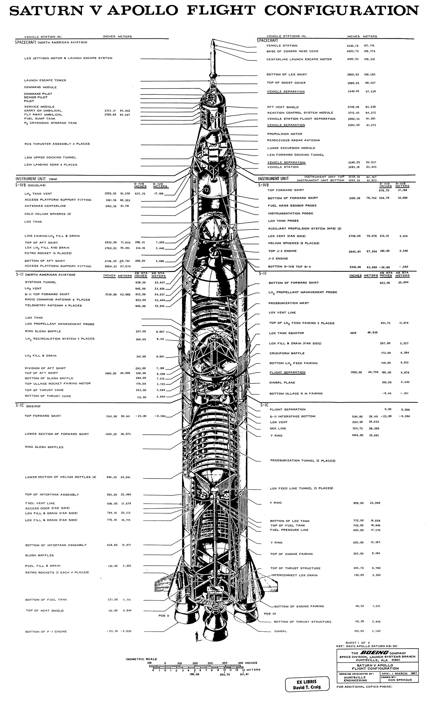
Implementation details
Snapshot ID
Datetime stamp (start of backup)
Restore defaults to latest
Restores use auto_bootstrap: false
Nodes already have their data!
Anti-corruption measures
Metadata manifest created after backup has succeeded
If any node fails, entire restore fails

Slide 23

Extras
Automated runs using cron job, Ansible Tower or CD frameworks
Restricted-access backups for dev teams using internal service

Slide 24


Conclusions
Restore-focused backups are imperative for consistent restores
Ansible is easy to work with and provides centralized control with a distributed workload
Reliable backup restores are powerful and versatile
Notes:
3) Since completion, restores have been in demand for investigations. Dev velocity has increased as a result.

Slide 25
Thank you!
Questions?

